Slide 1


TensorFlow in Python: An Introduction
This presentation explores TensorFlow, a powerful open-source ML framework. We will cover key features such as its computational graph. We'll delve into why Python is ideal. Also we will compare TensorFlow versions. Get ready to unlock the potential of TensorFlow with Python.
by Jenisha Thummar
Notes:
1.7.2013
1
‹#›

Slide 2
Core Concepts: Tensors and Operations
What are Tensors?
Tensor Operations
Tensors are the fundamental data structure in TensorFlow. They are multi-dimensional arrays that hold numerical values.
TensorFlow provides a wide array of operations. These operations can be used to manipulate tensors.
Learn how to create and manipulate tensors in TensorFlow. Understand rank, shape, and data types.
Notes:
1.7.2013
2
‹#›

Slide 3
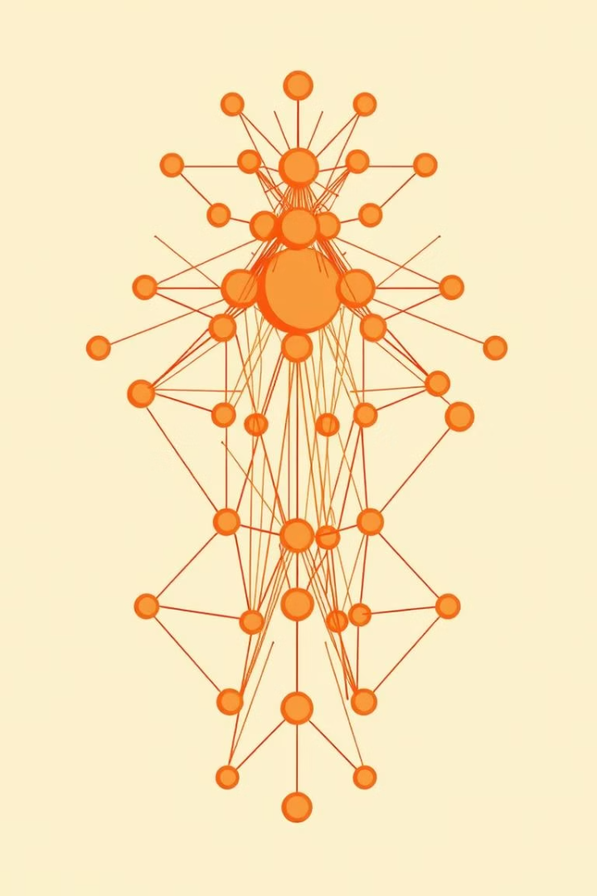





Building a Basic Neural Network
Define the Model
Specify layers: Dense, Activation.
Compile the Model
Choose optimizer, loss, metrics.
Train the Model
Use input data, labels, epochs.
Evaluate the Model
Assess accuracy and loss.
Create a neural network, compile it with essential components. Train it with appropriate data, and then evaluate its performance.
Notes:
1.7.2013
3
‹#›

Slide 4
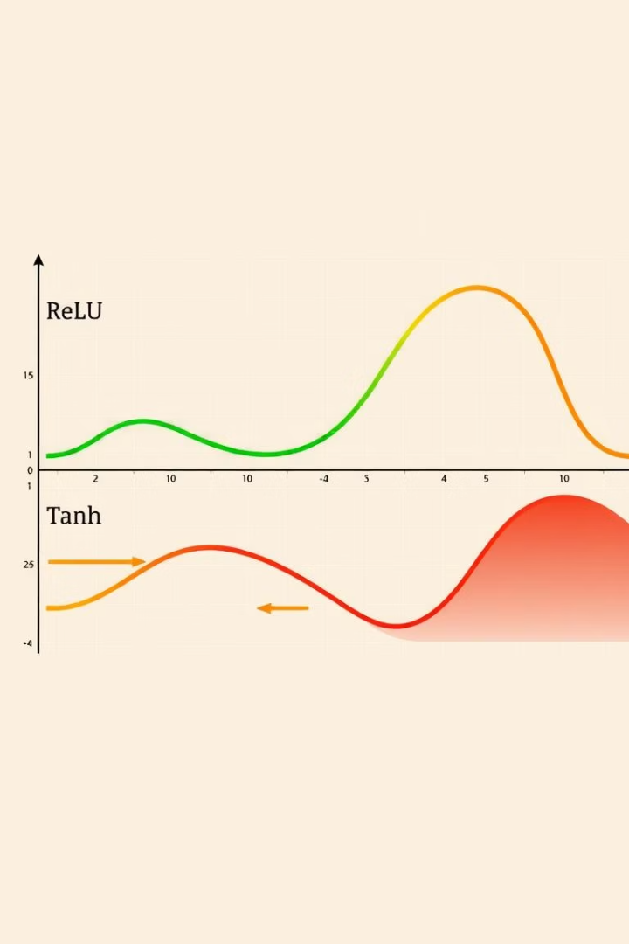

Activation Functions Explained
ReLU
Common choice for hidden layers.
Sigmoid
Output between 0 and 1, for binary tasks.
Tanh
Output between -1 and 1.
Softmax
Multi-class probability distribution.
Selecting the right activation function is critical. ReLU is a popular choice. Sigmoid and Tanh offer unique output ranges. Softmax is ideal for multi-class problems.
Notes:
1.7.2013
4
‹#›

Slide 5

TensorFlow
A comprehensive overview of using TensorFlow for machine learning in Python.
Notes:
1.7.2013
12
‹#›

Slide 6






Optimizers: Guiding the Training Process
Gradient Descent
Basic optimization algorithm.
Adam
Adaptive Moment Estimation, popular.
SGD
Stochastic Gradient Descent, classic.
RMSprop
Root Mean Square Propagation.
Choosing the right optimizer can dramatically improve training. Adam is widely used. SGD is a classic choice. RMSprop offers its own advantages.
Notes:
1.7.2013
5
‹#›

Slide 7



Convolutional Neural Networks (CNNs)
2
Pooling Layers
Downsampling.
1
Convolutional Layers
Feature extraction.
Flattening
3
Convert to dense input.
CNNs are powerful for image processing. Convolutional layers extract features. Pooling layers reduce dimensionality. Flattening prepares data for final classification. Use CNNs for image classification.
Notes:
1.7.2013
6
‹#›

Slide 8
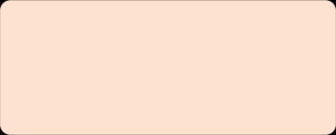
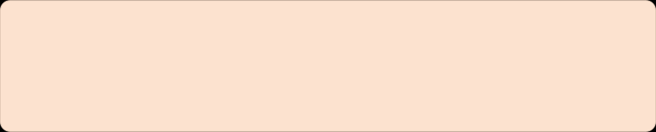
Recurrent Neural Networks (RNNs)
1
Recurrent Layers
LSTM, GRU.
2
Sequential Data
Text, Time Series.
RNNs excel at processing sequential data. LSTM and GRU layers handle long-range dependencies. Apply RNNs to sentiment analysis using datasets such as IMDb.
Notes:
1.7.2013
7
‹#›

Slide 9

TensorFlow
TensorFlow is a powerful open-source library for numerical computation and large-scale machine learning. Developed by Google, it provides a flexible architecture that allows you to deploy computation to one or more CPUs or GPUs in a desktop, server, or mobile device with a single API.
Notes:
1.7.2013
11
‹#›

Slide 10




TensorFlow Datasets and Data Pipelines
TF Datasets
Pre-built datasets.
tf.data API
Efficient data loading.
Preprocessing
Normalization, Augmentation.
TensorFlow provides tools for efficient data handling. Use TensorFlow Datasets. Create data pipelines with the tf.data API. Preprocess data for optimal model performance.
Notes:
1.7.2013
8
‹#›

Slide 11
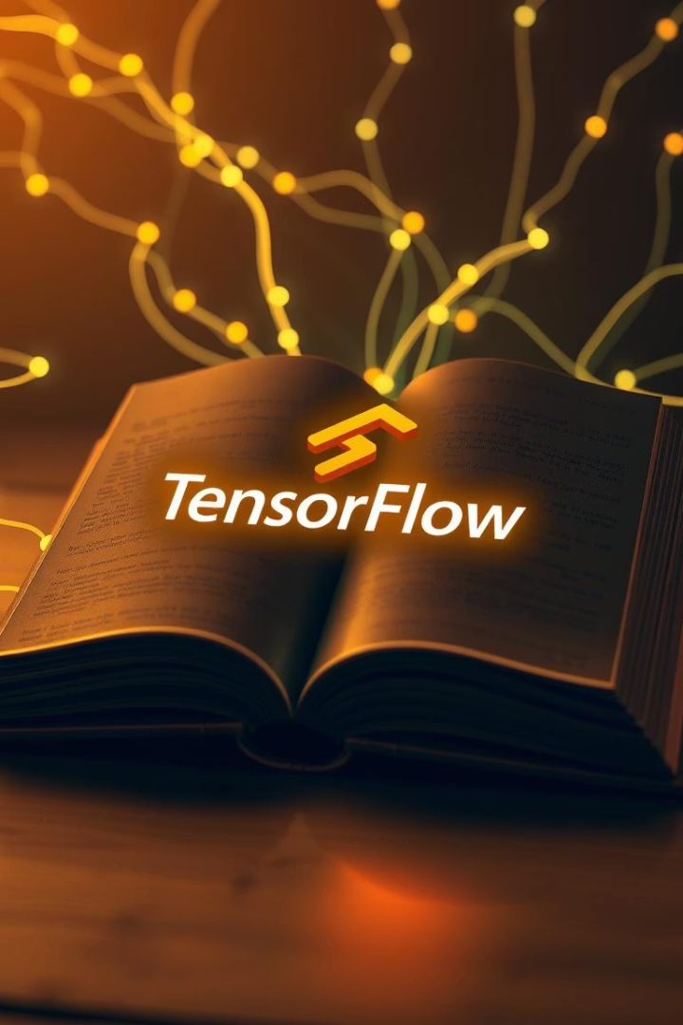

Conclusion and Further Learning
TensorFlow: ML framework
Key Takeaways: Tensors, Models
Resources: Documentation, tutorials
TensorFlow is a powerful framework for ML. Key concepts include tensors, models, and training. Explore TensorFlow documentation. We hope you enjoy and lear
A comprehensive overview of using TensorFlow for machine learning in Python.
Notes:
1.7.2013
10
‹#›

Slide 12




Benefits of Using TensorFlow
Scalability
1
Train on GPUs/TPUs.
2
Flexibility
Wide applications.
3
Community
Extensive support.
4
Production
TensorFlow Serving.
TensorFlow offers scalability with GPU/TPU support. Its flexibility suits various applications. A large community provides extensive support. TensorFlow Serving aids production deployment.
Notes:
1.7.2013
9
‹#›

